Slide 1
Problem Statement
Big Mountain Resort is reevaluating its ticket model scheme in hopes of increasing
profitability.
This presentation presents the finding of analyzing available data from other resorts in Big Mountain’s market share.
Notes:
<number>
Hypothesis: Create a Hypothesis with an emphasis on SMART principles. (S – Specific, M – Measurable, A – Achievable, R – Realistic, T – Timebound). If you cannot do this, you do not have a good grasp on the business problem.
Context: With context, we have clearly identified the problem at hand and have elucidated on how our initiative may solve this problem, alongside the commercial implications this will have on the business.
Criteria for Success: Clearly defining the criteria for success ensures that the scope of your work is clearly defined and understood. Otherwise, if this isn’t defined – your work will never end which will result in mismatched expectations.
Scope of Solution Space: Scoping out the solution space ensures that the business initiative is SPECIFIC for a certain segment or area. This prevents solutions that have been developed being scaled and applied for all other business units that the solution may not be responsible or scalable for.
Constraints within Solution Space: Looking forward, what are the foreseeable problems we are likely to encounter? Could this be stakeholder resistance? Could this be we don’t have access to the right data?
Stakeholders to provide key insight: Who are the people I need to speak to, to get the answers I need for my data analysis?
What key data sources are required?
Based off my discussions with the key stakeholders – can we clearly list out all the data sources we need so we can make a highly targeted request as opposed to a scatter-gun approach where we ask for a bit of everything?

Slide 2
Problem Statement
Can Big Mountain Resort increase its ticket price enough to offset recent the recent
increase in operating cost?
H
1
Context
4
Constraints within solution space
Big Mountain Resort fears that it is under-capitalising on its facilities by using its current ticket pricing paradigm. It also has recently added a chair lift to the facility which increases there operating cost of the resort.
Location of each resort may play a significant role in determining what price points customers will tolerate. Customers are unlikely to tolerate a large increase in ticket price even if analysis suggests the price is fair.
2
Criteria for success
5
Stakeholders to provide key insight
Determine an increase in ticket price that covers the increase in operating cost and increases profitability while maintaining competitive pricing with similar resorts.
Jimmy Blackburn, Director of operations
Alesha Eisen, Database Manager
3
Scope of solution space
6
Key data sources
Increasing ticket price.
CSV file received from Alesha.
H
D
E
I
P
Notes:
<number>
Hypothesis: Create a Hypothesis with an emphasis on SMART principles. (S – Specific, M – Measurable, A – Achievable, R – Realistic, T – Timebound). If you cannot do this, you do not have a good grasp on the business problem.
Context: With context, we have clearly identified the problem at hand and have elucidated on how our initiative may solve this problem, alongside the commercial implications this will have on the business.
Criteria for Success: Clearly defining the criteria for success ensures that the scope of your work is clearly defined and understood. Otherwise, if this isn’t defined – your work will never end which will result in mismatched expectations.
Scope of Solution Space: Scoping out the solution space ensures that the business initiative is SPECIFIC for a certain segment or area. This prevents solutions that have been developed being scaled and applied for all other business units that the solution may not be responsible or scalable for.
Constraints within Solution Space: Looking forward, what are the foreseeable problems we are likely to encounter? Could this be stakeholder resistance? Could this be we don’t have access to the right data?
Stakeholders to provide key insight: Who are the people I need to speak to, to get the answers I need for my data analysis?
What key data sources are required?
Based off my discussions with the key stakeholders – can we clearly list out all the data sources we need so we can make a highly targeted request as opposed to a scatter-gun approach where we ask for a bit of everything?

Slide 3
The Final Recommendation
Add a chair lift in order to support a new run with an increased vertical drop of 150ft.
Increase the ticket price by $6.00 to $87.00.

Slide 4
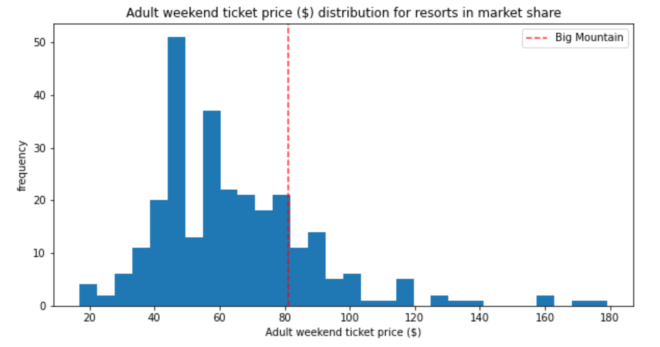
Distribution of Ticket Prices

Slide 5
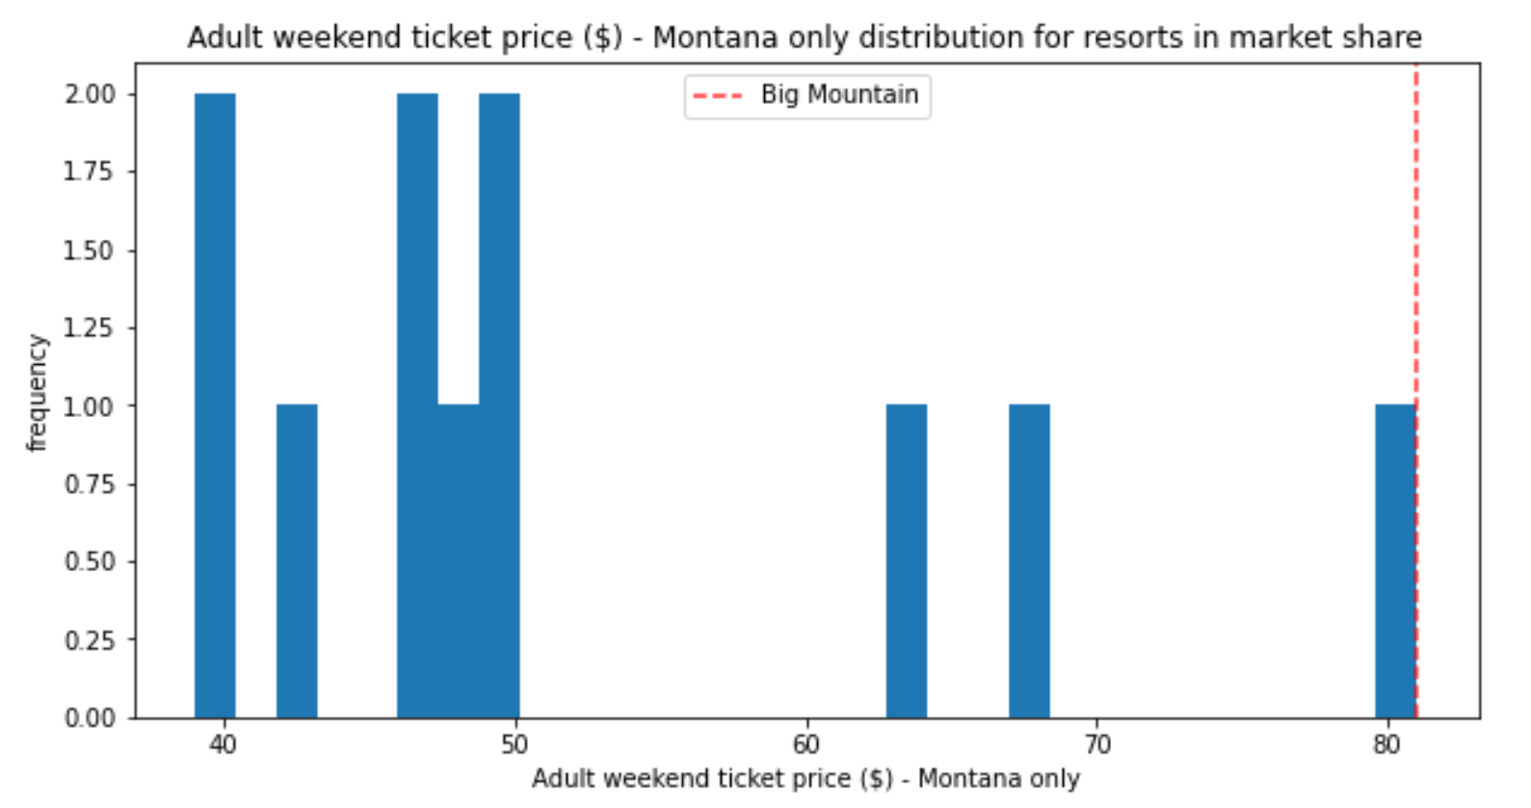
Distribution of Ticket Prices

Slide 6
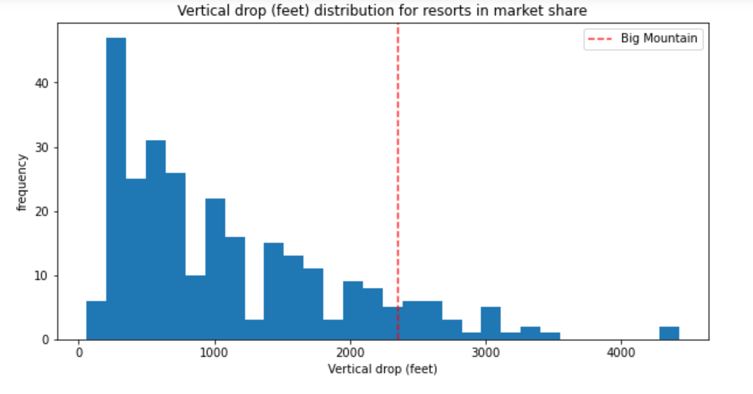
Distribution of Vertical Drops

Slide 7
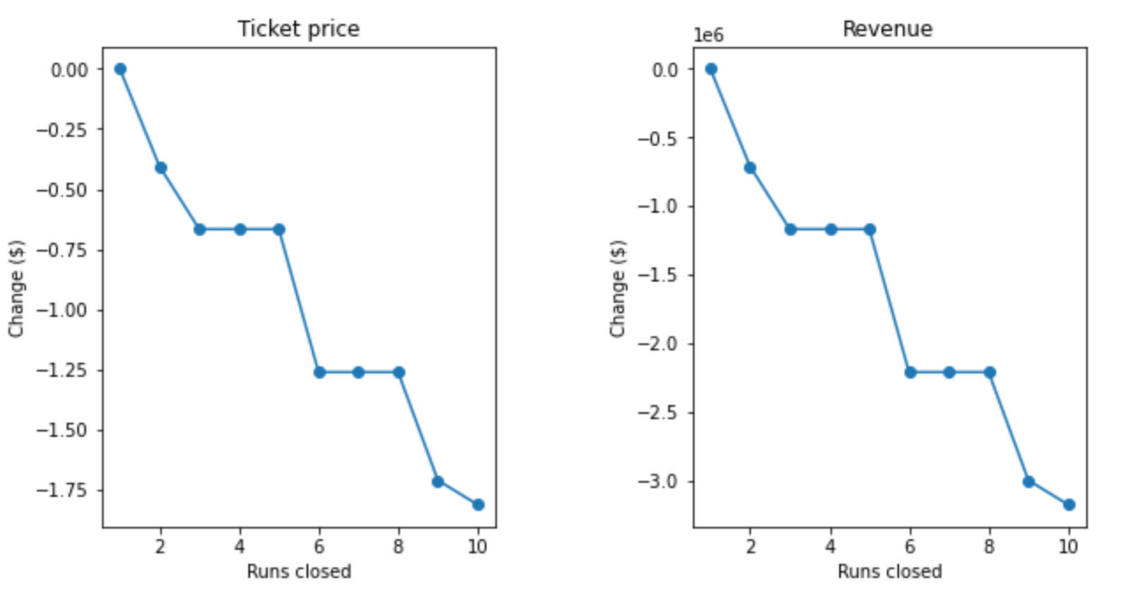
Effect of Closing Runs
Decreased support for tick price and decreased revenue are predicted.

Slide 8
Summary
Big Mountain is in the upper end of resorts in its market share
It is already the most expensive resort in its state
But, there is room for increasing the ticket price
By following the recommendations in this presentation Big Mountain can cover the cost of those additions as well as increase profits beyond that.
Summary of Recommendations
Add a chair lift in order to support a new run with an increased vertical drop of 150ft.
Increase the ticket price by $6.00 to $87.00.

